Slide 1
Electromagnetic Waves and Optics
Physics Unit 11
Notes:
Physics Unit 11

Slide 2
This Slideshow was developed to accompany the textbook
OpenStax Physics
Available for free at https://openstaxcollege.org/textbooks/college-physics
By OpenStax College and Rice University
2013 edition
Some examples and diagrams are taken from the textbook.
Slides created by
Richard Wright, Andrews Academy
rwright@andrews.edu

Slide 3
11-01 Maxwell’s Equations and Production of EM Waves
In this lesson you will…
• Restate Maxwell’s equations.
• Describe the electric and magnetic waves as they move out from a source, such as an AC generator.
• Explain the mathematical relationship between the magnetic field strength and the electrical field strength.
• Calculate the maximum strength of the magnetic field in an electromagnetic wave, given the maximum electric field strength.

Slide 4
11-01 Maxwell’s Equations and Production of EM Waves
James Clerk Maxwell – Scottish physicist who showed that electricity and magnetism together create electromagnetic waves
Maxwell’s Equations
Gauss’s Law
$$∇⋅E=\frac{ρ}{ε_{0}}$$
Gauss’s Law for Magnetism
(no magnetic monopoles)
$$∇⋅B=0$$
Faraday’s Law
$$∇×E=−\frac{∂B}{∂t}$$
Ampere’s Circuit Law
$$∇×B=μ_{0}J+μ_{0}ε_{0}\frac{∂E}{∂t}$$
Notes:
Operators are divergence (upside down Δ with dot) – how does it spread out
Curl (how does it twist)

Slide 5
11-01 Maxwell’s Equations and Production of EM Waves
Maxwell predicted that the speed of electromagnetic waves would be
$$c=\frac{1}{\sqrt{μ_{0}ε_{0}}}=3.00×{10}^{8} m/s$$
$$ε_{0}=8.85×{10}^{−12} C^{2}/Nm^{2}$$
$$μ_{0}=4π×{10}^{−7} T/Nm$$
Heinrich Hertz was the first scientist to generate and receive EM waves.

Slide 6
11-01 Maxwell’s Equations and Production of EM Waves
Creation of electromagnetic waves
Two wires are connected to either side of an AC generator to form an antenna.
As the emf of the generator changes a potential difference between the ends of the wires is created.
The potential difference makes an electric field.
As the AC generator changes polarity, the electric field direction is reversed.

Slide 7
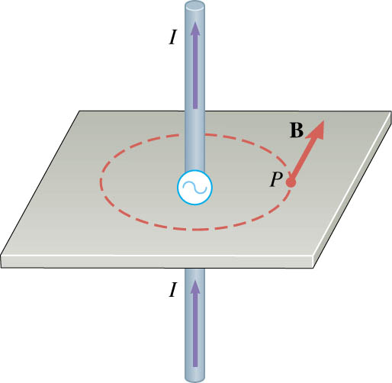
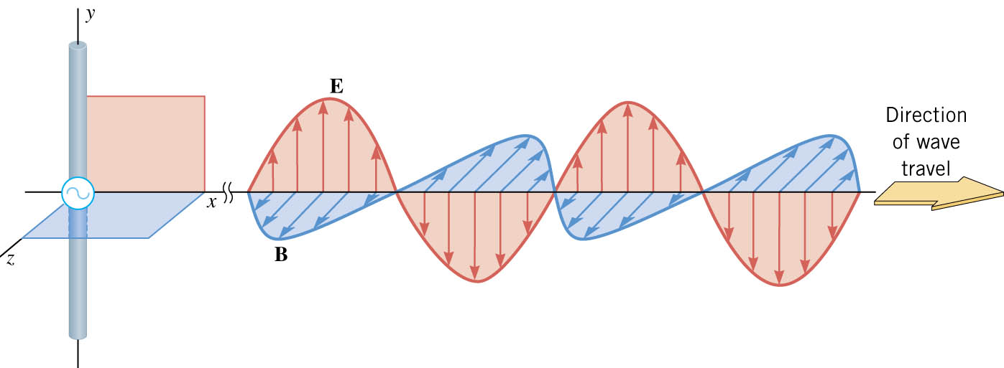
11-01 Maxwell’s Equations and Production of EM Waves
Also, as the potential difference changes directions, the charges in the antenna run to the other ends creating a current.
Current creates a B-field perpendicular to the wire.
Electromagnetic waves are both E-field and B-field.
Field are perpendicular to each other and the direction of travel.
Transverse waves.

Slide 8
11-01 Maxwell’s Equations and Production of EM Waves
To detect EM waves
Need antenna to receive either E-field or B-field.
E-field – Straight antenna
The E-field causes electrons to flow in the opposite direction creating current that changes with time as the E-field changes.
The circuitry attached to the antenna let you pick the frequency (LC-circuit) and amplify it for speakers.

Slide 9
11-01 Maxwell’s Equations and Production of EM Waves
B-field – Loop antenna
The B-field flowing through the loop induces a current that changes as the B-field changes.

Slide 10
11-01 Maxwell’s Equations and Production of EM Waves
Relating the E-field and B-field strengths
Stronger E-field creates greater current which makes greater B-field
$$\frac{E}{B}=c$$

Slide 11
11-01 Maxwell’s Equations and Production of EM Waves
EM waves can travel through a vacuum or material because E- and B-fields can exist in both.
All EM waves travel the same speed in a vacuum.
$c = 3.00×{10}^{8} m/s$
Frequency of the wave is determined by the source.

Slide 12
11-01 Homework
Produce waves. Do homework.
Read 24.3, 24.4

Slide 13
11-02 The EM Spectrum and Energy
In this lesson you will…
• Explain why the higher the frequency, the shorter the wavelength of an electromagnetic wave.
• Draw a simplified electromagnetic spectrum, indicating the relative positions, frequencies, and spacing of the different types of radiation bands.
• Explain how the energy and amplitude of an electromagnetic wave are related.

Slide 14
11-02 The EM Spectrum and Energy
Notes:
The wavelength/frequency determines the type of EM wave

Slide 15
11-02 The EM Spectrum and Energy
For EM waves in vacuum $v=c=299792458 m/s$
This is exact and is used to define the meter
As EM waves travel through other substances, like plastic, it travels slower.
For all waves $v=fλ$
Notes:
Use $c=3.00×{10}^{8}$ m/s for most calculations

Slide 16
11-02 The EM Spectrum and Energy
An EM wave has a frequency of 90.7 MHz. What is the wavelength of this wave? What type of EM wave is it?
λ = 3.31 m
Radio wave (FM)
Notes:
$$c=fλ→3.00×{10}^{8}\frac{m}{s}=\left(90.7×{10}^{6} Hz\right)λ→λ=3.31 m$$

Slide 17
11-02 The EM Spectrum and Energy
Wave’s energy is proportional to the amplitude squared
Wave’s intensity
$$I_{ave}=\frac{cε_{0}E_{0}^{2}}{2}$$
$$I_{ave}=\frac{cB_{0}^{2}}{2μ_{0}}$$
$$I_{ave}=\frac{E_{0}B_{0}}{2μ_{0}}$$
$I_{0}=2I_{ave}$ and $I=\frac{P}{A}$
Notes:
Third eq from substituting $cB_{0}=E_{0}$ into the 2nd eq

Slide 18
11-02 The EM Spectrum and Energy
A certain microwave oven can produce 1500 W of microwave radiation over an area that is 30 cm by 30 cm.
What is the intensity in W/m²?
$1.67×{10}^{4}\frac{W}{m^{2}}$
Calculate the peak electric field strength, $E_{0}$, in these waves.
$3.55×{10}^{3}\frac{N}{C}$
What is the peak magnetic field strength, $B_{0}$?
$1.18×{10}^{−5} T$
Notes:
$$I=\frac{P}{A}$$
$$I=\frac{1500 W}{0.3 m×0.3 m}=1.67×{10}^{4}\frac{W}{m^{2}}$$
$$I_{ave}=\frac{cε_{0}E_{0}^{2}}{2}$$
$$1.67×{10}^{4}\frac{W}{m^{2}}=\frac{\left(3.00×{10}^{8}\frac{m}{s}\right)\left(8.85×{10}^{−12}\frac{C^{2}}{Nm^{2}}\right)E_{0}^{2}}{2}$$
$$E_{0}^{2}=1.258×{10}^{7}\frac{N^{2}}{C^{2}}$$
$$E_{0}=3.55×{10}^{3}\frac{N}{C}$$
$$\frac{E}{B}=c$$
$$\frac{3.55×{10}^{3}\frac{N}{C}}{B}=3.00×{10}^{8}\frac{m}{s}$$
$$B=1.18×{10}^{−5} T$$

Slide 19
11-02 Homework
These are a whole spectrum of problems.
Read 25.1, 25.2, 25.3

Slide 20
11-03 The Laws of Reflection and Refraction
In this lesson you will…
• List the ways by which light travels from a source to another location.
• Explain reflection of light from polished and rough surfaces.
• Determine the index of refraction, given the speed of light in a medium.

Slide 21
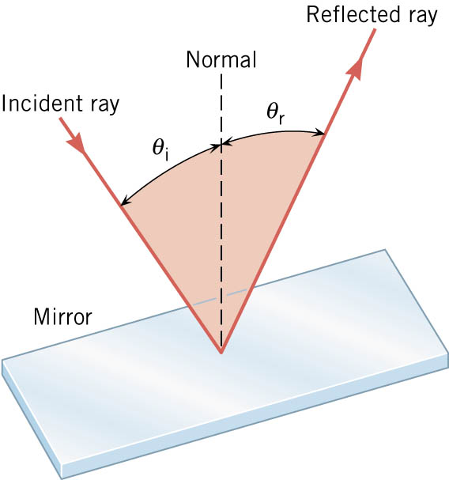
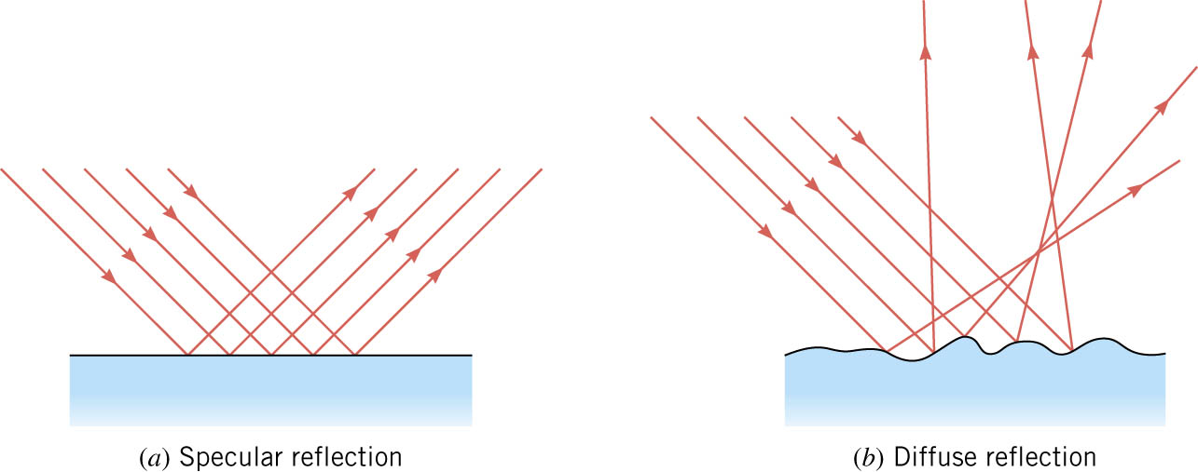
11-03 The Laws of Reflection and Refraction
Law of Reflection: θ_{r} = θ_{i}
Specular Reflection
Parallel light rays are reflected parallelly
Diffuse Reflection
Parallel light rays are scattered by irregularities in the surface.

Slide 22
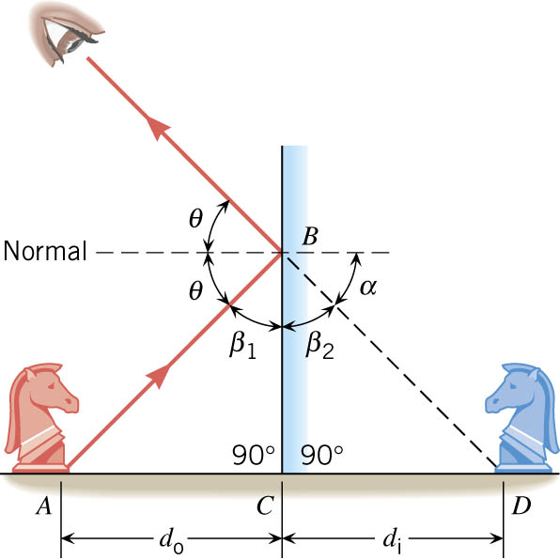
11-03 The Laws of Reflection and Refraction
Plane Mirror
Image is upright
Image is same size
Image is located as far behind the mirror as you are in front of it

Slide 23
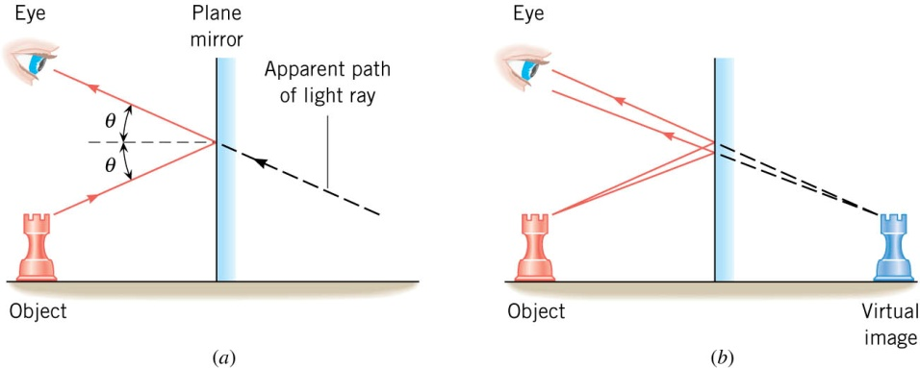
11-03 The Laws of Reflection and Refraction
Since light rays appear to come from behind mirror, the image is called a virtual image.
If light rays appear to come from a real location, the image is called a real image.
Real images can be projected on a screen, virtual images cannot.
Plane mirrors only produce virtual images.

Slide 24
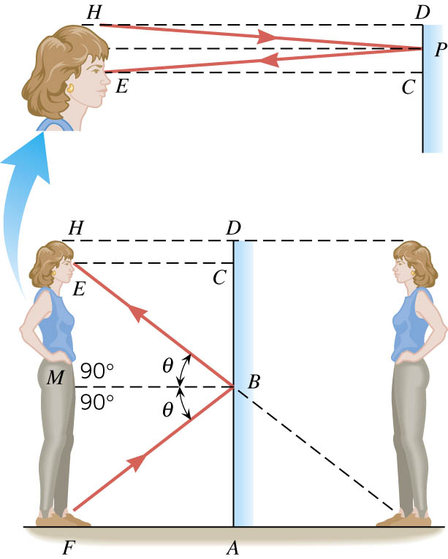
11-03 The Laws of Reflection and Refraction
How long must a plane mirror be to see your whole reflection?
From half way between your eyes and floor to half way between your eyes and the top of your head.

Slide 25
11-03 The Laws of Reflection and Refraction
Speed of light in a vacuum:
$c=3.00×{10}^{8}$ m/s
Light travels slower through materials due to light hitting, absorbed by, emitted by, and scattered by atoms.
Index of Refraction
Number to indicate relative speed of light in a material
$$n=\frac{c}{v}$$
Notes:
n = index of refraction
c = speed of light in vacuum
v = speed of light in material

Slide 26
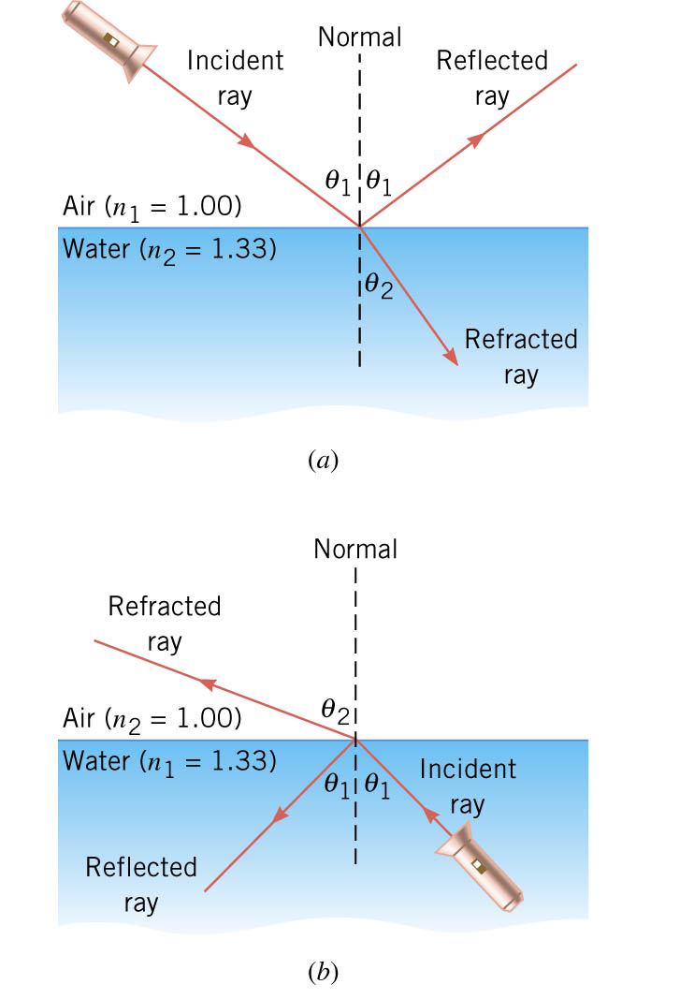
11-03 The Laws of Reflection and Refraction
When light hits the surface of a material part of it is reflected
The other part goes into the material
The transmitted part is bent (refracted)

Slide 27
11-03 The Laws of Reflection and Refraction
Snell’s Law (The Law of Refraction)
$$n_{1}\sin{θ_{1}}=n_{2}\sin{θ_{2}}$$
Where
n₁ = index of refraction of incident medium
n₂ = index of refraction of second medium
θ₁ = angle of incidence (measured to normal)
θ₂ = angle of refraction (measured to normal)
Notes:
To go from less optically dense to more optically dense, the ray is bent towards normal.
To go from more optically dense to less optically dense, the ray is bent away from the normal.
When the light goes from one material to another, it bends towards the slower material.

Slide 28
11-03 The Laws of Reflection and Refraction
You shine a laser into a piece of clear material. The angle of incidence is 35°. You measure the angle of refraction as 26°. What is the material?
Ice
What is the speed of light in the material?
$v=2.29×{10}^{8}$ m/s
Notes:
$$n_{1}\sin{θ_{1}}= n_{2}\sin{θ_{2}}$$
$$1.00\sin{35°}=n\sin{26°}→n=1.308$$
$$Table says this should be ice.$$
$$n=\frac{c}{v}→1.308=\frac{3.00×{10}^{8}\frac{m}{s}}{v}→v=2.29×{10}^{8} m/s$$

Slide 29
11-03 Homework
Let your answers reflect the truth.
Read 25.4, 25.5

Slide 30
11-04 Total Internal Reflection
In this lesson you will…
• Explain the phenomenon of total internal reflection.
• Describe the workings and uses of fiber optics.
• Analyze the reason for the sparkle of diamonds.
• Explain the phenomenon of dispersion and discuss its advantages and disadvantages.

Slide 31
11-04 Total Internal Reflection
Total Internal Reflection
When light hits a interface between two types of media with different indices of refractions
Some is reflected
Some is refracted
Critical angle
Angle of incidence where refracted angle is 90$°$
Angles of incidence larger than this cause the refracted angle to be inside the material. This can’t happen, so no refraction occurs.

Slide 32
11-04 Total Internal Reflection
Critical angle
$θ_{2}=90°$
$n_{1}\sin{θ_{1}}=n_{2}\sin{θ_{2}}$
$n_{1}\sin{θ_{c}}=n_{2}\sin{90°}$
$θ_{c}=\sin^{−1}{\frac{n_{2}}{n_{1}}}$
Where $n_{1}>n_{2}$

Slide 33
11-04 Total Internal Reflection
What is the critical angle from cubic zirconia (n=2.16) to air? Will an angle of $25°$ produce total internal reflection?
27.7$°$
No
Notes:
$$θ_{c}=\sin^{−1}{\frac{n_{2}}{n_{1}}}$$
$$θ_{c}=\sin^{−1}{\frac{1.000293}{2.15}}$$
$$θ_{c}=27.7°$$

Slide 34
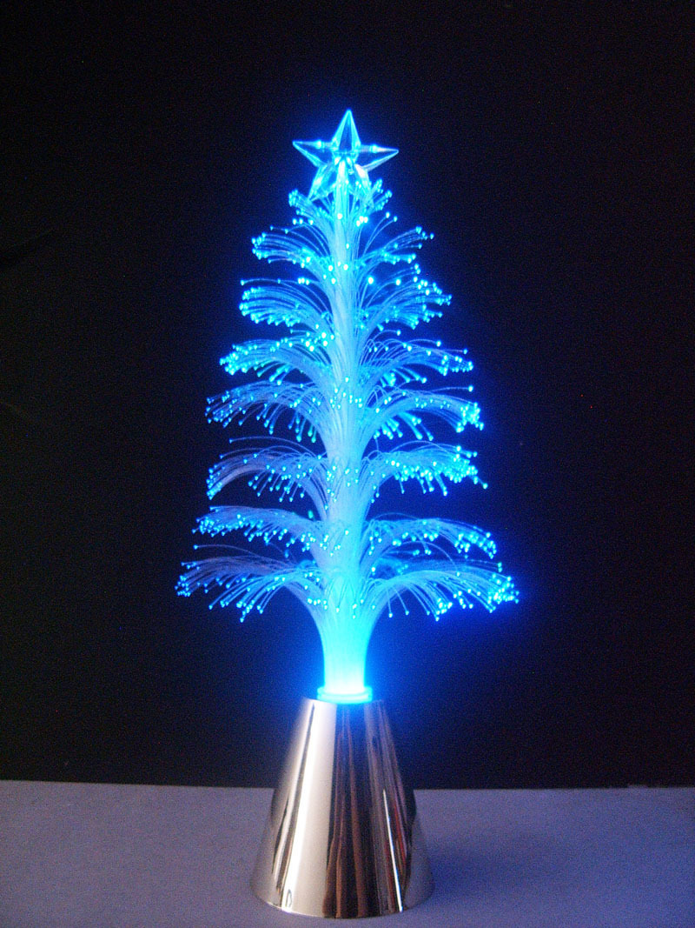
11-04 Total Internal Reflection
Uses of total internal reflection
Fiber optics for
Endoscopes
Telecommunications
Decorations
Binoculars/telescopes
Makes them shorter
Reflectors
Gemstones
Cut so that light only exits at certain places

Slide 35
11-04 Total Internal Reflection
Dispersion
Each wavelength of light has a different index of refraction
Red — lowest
Violet — highest
When light is refracted, the violet bends more than red, which splits the colors

Slide 36
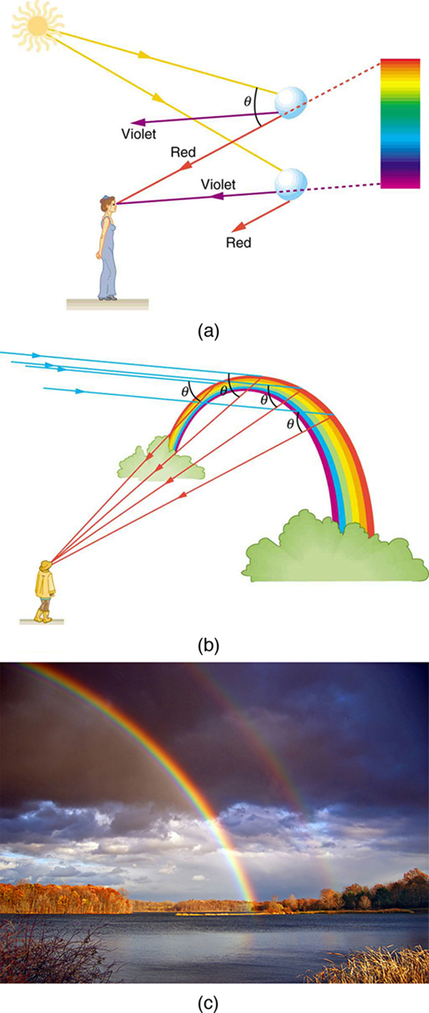
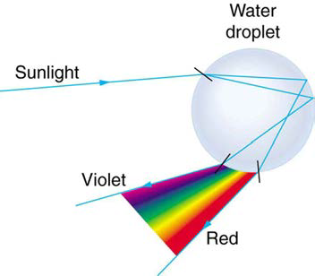
11-04 Total Internal Reflection
Rainbows
Dispersion by refraction with internal reflection

Slide 38
11-04 Homework
“I have set my rainbow in the clouds, and it will be the sign of the covenant between me and the earth.” Genesis 9:13
Read 25.6

Slide 39
11-05 Image Formation by Lenses
In this lesson you will…
• List the rules for ray tracking for thin lenses.
• Illustrate the formation of images using the technique of ray tracking.
• Determine power of a lens given the focal length.

Slide 40
11-05 Image Formation by Lenses
Lens - Made from transparent material, usually with a curved edge.
Converging Lens – thick middle, thin edge (convex)
Diverging Lens – thin middle, thick edge (concave)
Power of lens
$P=\frac{1}{f}$
Unit: diopters (D)

Slide 41
11-05 Image Formation by Lenses
Ray Diagrams - Converging Lenses
Ray 1 – Parallel to principal axis, bends through F
Ray 2 – Through F, bends parallel to principal axis
Ray 3 – Goes through center of lens, does not bend
Object beyond 2F,
Image inverted, real, smaller between F and 2F
Object
2F
F
F
2F
Image
Notes:
Like camera

Slide 42
11-05 Image Formation by Lenses
Object between 2F and F
Image real, inverted, larger beyond 2F
Image
2F
F
F
2F
Object
Notes:
projector

Slide 43
11-05 Image Formation by Lenses
Object between F and lens
Image virtual, upright, between 2F and F on side with object
2F
F
F
2F
Image
Object
Notes:
Like magnifying glass

Slide 44
11-05 Image Formation by Lenses
Ray 1 now bends away from axis so that it looks like it came from F
Ray 2 starts by aiming at far F
Ray 3 same as before
Diverging Lens
Image virtual, upright, smaller between F and lens
2F
Object
F
Image
F
2F
Notes:
Ray 1 now bends away from axis so that it looks like it came from F
Ray 2 starts by aiming at far F
Ray 3 same as before
Like some glasses

Slide 45
11-05 Image Formation by Lenses
Thin-lens equation
$\frac{1}{f}=\frac{1}{d_{o}}+\frac{1}{d_{i}}$
Converging Lens
f +
d_{o} + if real (left side)
d_{i} + if real (right side)
Magnification equation
$m=\frac{h_{i}}{h_{o}}=−\frac{d_{i}}{d_{o}}$
Diverging Lens
f -
d_{o} + if real (left side)
d_{i} - if virtual (left side)
Notes:
Lenses can be put in combination where a real image from the first lens is the object of the second lens. This is done in a microscope and telescope.
Lab idea: make a telescope or microscope on optics bench.

Slide 46
11-05 Image Formation by Lenses
Lens Reasoning Strategy
Examine the situation to determine that image formation by a lens is involved.
Determine whether ray tracing, the thin lens equations, or both are to be employed. A sketch is very useful even if ray tracing is not specifically required by the problem. Write symbols and values on the sketch.
Identify exactly what needs to be determined in the problem (identify the unknowns).
Make a list of what is given or can be inferred from the problem as stated (identify the knowns). It is helpful to determine whether the situation involves a case 1, 2, or 3 image. While these are just names for types of images, they have certain characteristics (given in Table 25.3) that can be of great use in solving problems.
If ray tracing is required, use the ray tracing rules listed near the beginning of this section.
Most quantitative problems require the use of the thin lens equations. These are solved in the usual manner by substituting knowns and solving for unknowns. Several worked examples serve as guides.
Check to see if the answer is reasonable: Does it make sense? If you have identified the type of image (case 1, 2, or 3), you should assess whether your answer is consistent with the type of image, magnification, and so on.

Slide 47
11-05 Image Formation by Lenses
A child is playing with a pair of glasses with diverging lenses. The focal length is 20 cm from the lens and his eye is 5 cm from the lens. A parent looks at the child’s eye in the lens. If the eye is the object, where is the image located?
4 cm behind the lens
If his eye is really 3 cm across, how big does it appear?
h_{i} = 2.4 cm
Notes:
$$\frac{1}{f}=\frac{1}{d_{o}}+\frac{1}{d_{i}}→\frac{1}{−20 cm}=\frac{1}{5 cm}+\frac{1}{d_{i}}→\frac{1}{−20}−\frac{1}{5}=\frac{1}{d_{i}}→\frac{1}{d_{i}}=−0.25→−4 cm$$
$$\frac{h_{i}}{h_{o}}=−\frac{d_{i}}{d_{o}}→\frac{h_{i}}{3 cm}= −\frac{−4 cm}{5 cm}→h_{i} = 2.4 cm$$
This is like “Coke bottle” lenses.

Slide 48
11-05 Homework
Form an image in your mind of doing well.
Read 25.7

Slide 49
11-06 Image Formation by Mirrors
In this lesson you will…
• Illustrate image formation in a flat mirror.
• Explain with ray diagrams the formation of an image using spherical mirrors.
• Determine focal length and magnification given radius of curvature, distance of object and image.

Slide 50
11-06 Image Formation by Mirrors
Concave: bends in
Convex: bends out
Notes:
Remember concave because it makes a small cave

Slide 51
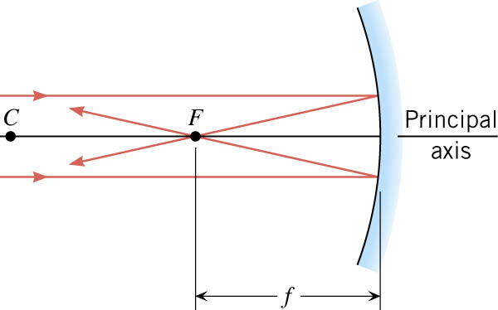
11-06 Image Formation by Mirrors
Normals are always perpendicular to the surface and pass through the center of curvature, C.
Law of Reflection says that the angle to the normal is the same for the incident and reflected rays
Principal axis: imaginary line through C and the center of the mirror.
Focal point (F): parallel rays strike the mirror and converge at the focal point.
Focal length (f): distance between F and mirror
Concave mirrors: $f=\frac{1}{2}R$
Convex mirrors: $f=−\frac{1}{2}R$
Notes:
R = radius of curvature

Slide 52
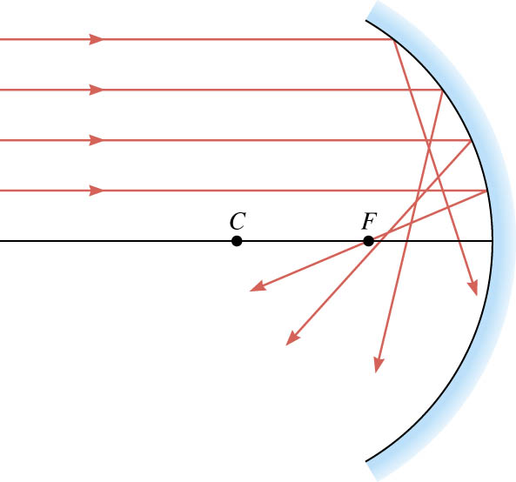
11-06 Image Formation by Mirrors
Spherical aberration
Rays far from the principle axis actually cross between F and the mirror.
Fix this by using a parabolic mirror.

Slide 53
11-06 Image Formation by Mirrors
Ray tracing diagram: Diagram used to find the location and type of image produced.
Notice the rays start at the top of the object.

Slide 54
11-06 Image Formation by Mirrors
Concave Mirror
Ray 1 – Parallel to principal axis, strikes mirror and reflects through F
Ray 2 – Through F, strikes mirror and reflects parallel to principal axis
Ray 3 – Through C, strikes mirror and reflects back through C
Object beyond C – image is real, inverted and smaller between C and F
Object
C
F
Image
Notes:
Like a telescope

Slide 55
11-06 Image Formation by Mirrors
Object between C and F
Image inverted, real, and larger beyond C
Image
C
Object
F
Notes:
Like a projector

Slide 56
11-06 Image Formation by Mirrors
Object between F and mirror
Image upright, virtual, larger behind mirror
C
F
Object
Image
Notes:
Like a makeup mirror

Slide 57
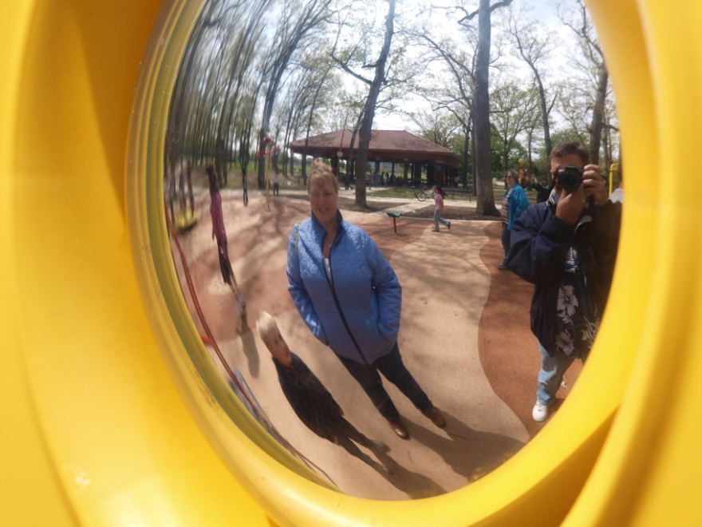
11-06 Image Formation by Mirrors
Convex Mirrors
Image upright, virtual, smaller behind mirror between F and mirror
Object
Image
F
C
Notes:
Like passenger side view mirror

Slide 58
11-06 Image Formation by Mirrors
Mirror Equation:
$$\frac{1}{f}=\frac{1}{d_{o}}+\frac{1}{d_{i}}$$
Where
f = focal length (negative if convex)
d₀ = object distance
d_{i} = image distance (negative if virtual)
Notes:
f= distance between F and mirror
d₀ = distance between object and mirror
d_{i} = distance between image and mirror
These were discovered through the use of geometry and similar triangles.

Slide 59
11-06 Image Formation by Mirrors
Magnification Equation:
$$m=\frac{h_{i}}{h_{o}}=−\frac{d_{i}}{d_{o}}$$
Where
m = magnification
h_{o} = object height
h_{i} = image height (negative if inverted)
d₀ = object distance
d_{i} = image distance (negative if virtual)

Slide 60
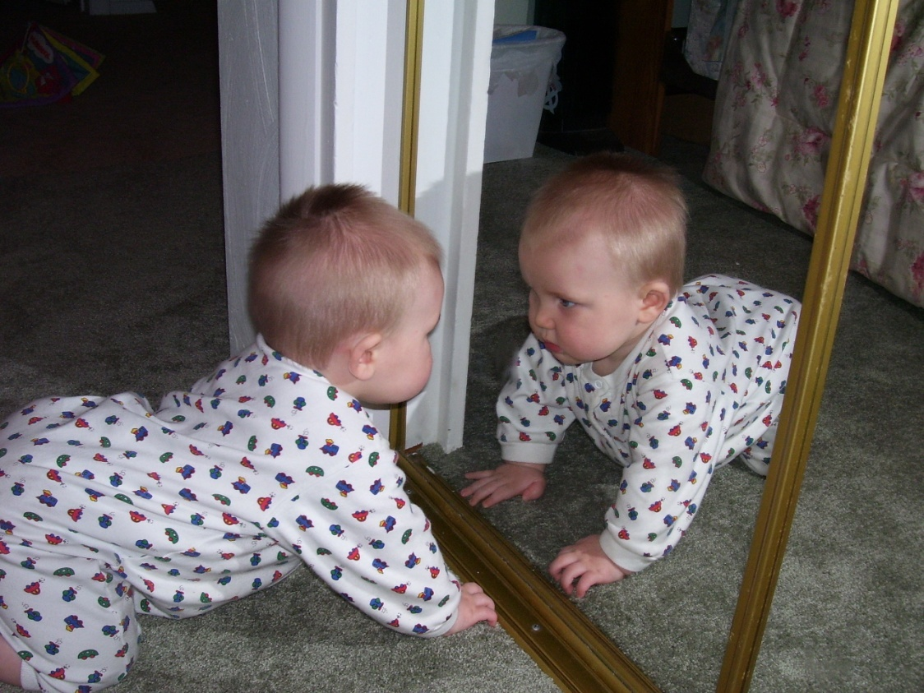
11-06 Image Formation by Mirrors
A 0.5-m high toddler is playing 10 m in front of a concave mirror with radius of curvature of 7 m.
What is the location of his image?
d_{i} = 5.38 m
What is the height of his image?
h_{i} = -0.269 m
Notes:
$$f=\frac{1}{2}R=\frac{1}{2}(7 m)=3.5 m$$
$$\frac{1}{f}=\frac{1}{d_{o}}+\frac{1}{d_{i}}→\frac{1}{3.5}=\frac{1}{10}+\frac{1}{d_{i}}→\frac{1}{3.5}−\frac{1}{10}=\frac{1}{d_{i}}→\frac{1}{d_{i}}=0.1857→d_{i}=5.38 m$$
$$m = −\frac{d_{i}}{d_{o}} =\frac{h_{i}}{h_{o}}→ −\frac{5.38}{10}=\frac{h_{i}}{0.5}→h_{i}=−0.269m$$

Slide 61
11-06 Image Formation by Mirrors
A 0.5-m high toddler is playing 10 m in front of a convex mirror with radius of curvature of 7 m.
What is the location of his image?
d_{i} = -2.59 m
What is the height of his image?
h_{i} = 0.130 m
Notes:
$$f=−\frac{1}{2}R=−\frac{1}{2}(7 m)=−3.5 m$$
$$\frac{1}{f}=\frac{1}{d_{o}}+\frac{1}{d_{i}}→\frac{1}{−3.5}=\frac{1}{10}+\frac{1}{d_{i}}→\frac{1}{−3.5}−\frac{1}{10}=\frac{1}{d_{i}}→\frac{1}{d_{i}}=−0.3857→d_{i}=−2.59 m$$
$$m=−\frac{d_{i}}{d_{o}}=\frac{h_{i}}{h_{o}}→\frac{2.59}{10}=\frac{h_{i}}{0.5}→h_{i}=0.130 m$$

Slide 62
11-06 Homework
The homework mirrors the lesson.
Read 26.1, 26.2, 26.3

Slide 63
11-07 Vision
In this lesson you will…
• Explain the image formation by the eye.
• Explain why peripheral images lack detail and color.
• Analyze the accommodation of the eye for distant and near vision.
• Identify and discuss common vision defects.
• Explain nearsightedness and farsightedness corrections.
• Explain the simple theory of color vision.
• Outline the coloring properties of light sources.

Slide 64
11-07 Vision
Cornea/Lens act as single thin lens
To see something in focus the image must be on the retina at back of eye
Lens can change shape to focus objects from different object lengths

Slide 65
11-07 Vision
Near-sightedness
Myopia
Image in front of retina
Correct with diverging lens
Far-sightedness
Hyperopia
Image behind retina
Correct with converging lens

Slide 66
11-07 Vision
Myopia – Near-sighted
Hyperopia – Far-sighted

Slide 67
11-07 Vision
What power of spectacle lens is needed to correct the vision of a nearsighted person whose far point is 20.0 cm? Assume the spectacle (corrective) lens is held 1.50 cm away from the eye by eyeglass frames.
-5.41 D
Notes:
You want this nearsighted person to be able to see very distant objects clearly. That means the spectacle lens must produce an image 20.0 cm
from the eye for an object very far away. An image 20.0 cm from the eye will be 18.5 cm to the left of the spectacle lens (see Figure 26.6).
Therefore, we must get $d_{i}=−18.5$ cm when $d_{o}≈∞$. The image distance is negative, because it is on the same side of the spectacle as the object.
Solution
Since $d_{i}$ and $d_{o}$ are known, the power of the spectacle lens can be found using $P=\frac{1}{f}=\frac{1}{d_{o}}+\frac{1}{d_{i}}$ as written earlier:
$$P=\frac{1}{∞}+\frac{1}{−0.185}$$
Since $\frac{1}{∞}=0$ , we obtain:
$$P=0−5.405 /m=−5.41 D$$

Slide 68
11-07 Vision
Color Vision
Photoreceptors in Eye
Rods
Very sensitive (see in dark)
No color info
Peripheral vision
Cones
Centered in center of retina
Work in only in bright light
Give color info
Essentially three types each picking up one primary color
Notes:
Color vision is actually much more complicated
And they say this just “happened”

Slide 69
11-07 Vision
Color
Non-light producing
The color we see is the color that reflects off the object
The object absorbs all the other colors
Light-producing
The color we see is the color produced

Slide 70
11-07 Vision
If you have normal color vision, you'll see a 42.
Red colorblind people will see a 2.
Green colorblind people will only see a 4.

Slide 71
11-07 Vision
If you have normal color vision, you see a 73 above.
If you are colorblind you will not see a number above.

Slide 72
11-07 Vision
If you have normal color vision you'll see a 74 above.
If you are red green colorblind, you'll see a 21.
If you are totally colorblind you will not see a number above.

Slide 73
11-07 Vision
If you have normal color vision you'll see a 26.
If you are red colorblind you will see a 6, if you're mildly red colorblind you'll see a faint 2 as well.
If you are green colorblind you'll see the a 2, and if you're mildly green colorblind a faint 6 as well.

Slide 74
11-07 Vision
If you have normal color vision you'll see a 12.
If you do not see 12 you are a liar. Everyone can see this one!

Slide 75
11-07 Homework
Isn’t it amazing how the eye works?
Read 27.1, 27.2, 27.3

Slide 76
11-08 Interference, Huygens’s Principle, Young’s Double Slit Experiment
In this lesson you will…
• Discuss the wave character of light.
• Identify the changes when light enters a medium.
• Discuss the propagation of transverse waves.
• Discuss Huygens’s principle.
• Explain the bending of light.
• Explain the phenomena of interference.
• Define constructive interference for a double slit and destructive interference for a double slit.

Slide 77
11-08 Interference, Huygens’s Principle, Young’s Double Slit Experiment
Wave Character of Light
When interacts with object several times it’s wavelength, it acts like a ray
When interacts with smaller objects, it acts like a wave
When light hits medium from a vacuum, it slows down
Frequency stays the same
$c=fλ$
$v=\frac{c}{n}=f\frac{λ}{n}$
$λ_{n}=\frac{λ}{n}$
Where $λ_{n}$ is wavelength in medium
n is index of refraction

Slide 78
11-08 Interference, Huygens’s Principle, Young’s Double Slit Experiment
Huygens’ Principle
Every point on a wave front acts as a source of tiny wavelets that move forward with the same speed as the wave; the wave front at a later instant is the surface that is tangent to the wavelets.

Slide 79
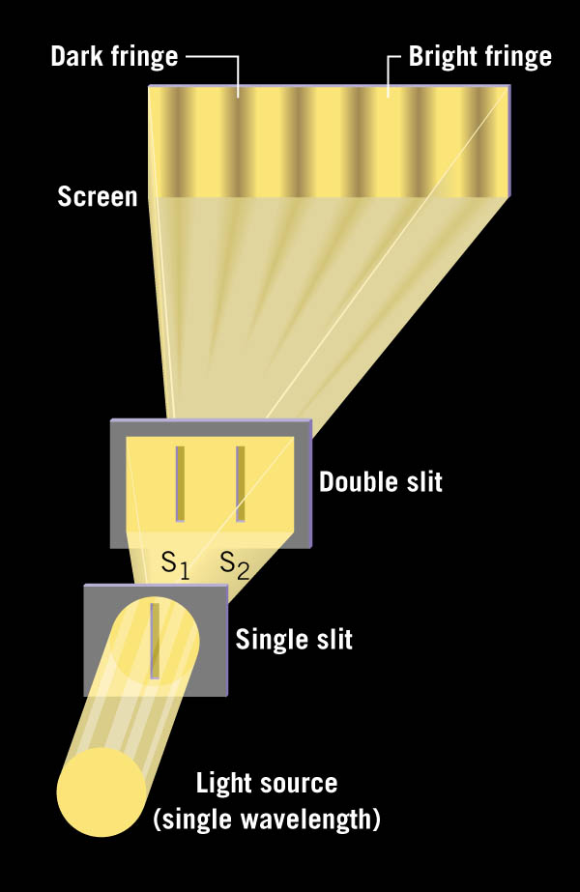
11-08 Interference, Huygens’s Principle, Young’s Double Slit Experiment
In 1801, Thomas Young showed that two overlapping light waves interfered and was able to calculate wavelength.
Notes:
Have laser and double slit for demo (optics bench?)

Slide 80
11-08 Interference, Huygens’s Principle, Young’s Double Slit Experiment

Slide 81
11-08 Interference, Huygens’s Principle, Young’s Double Slit Experiment
Bright fringe where ℓ₁ - ℓ₂ = mλ
Dark fringe where ℓ₁ - ℓ₂ = (m + ½)λ
Brightness of fringes varies
Center fringe the brightest and decreases on either side

Slide 82
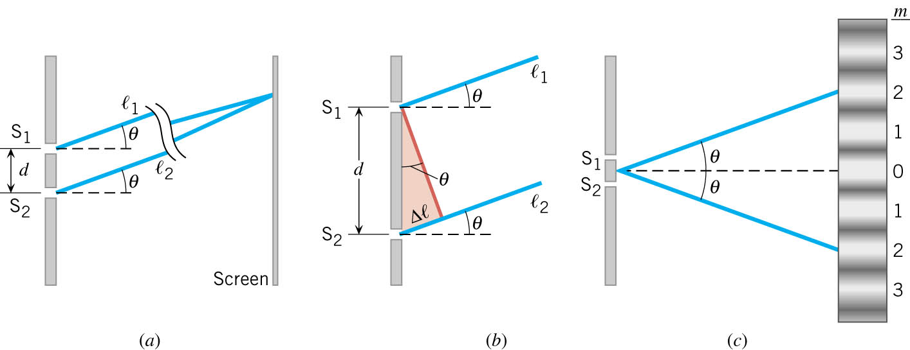
11-08 Interference, Huygens’s Principle, Young’s Double Slit Experiment
A) Rays from slits S₁ and S₂, which make approximately the same angle θ with the horizontal, strike a distant screen at the same spot.
B) The difference in the path lengths of the two rays is Δℓ = d sin θ.
C) The angle θ is the angle at which a bright fringe (m = 2, here) occurs on either side of the central bright fringe (m = 0)

Slide 83
11-08 Interference, Huygens’s Principle, Young’s Double Slit Experiment
Δℓ = d sin θ
Bright fringe Δℓ = mλ
d sin θ = mλ
$$\sin{θ}=m\frac{λ}{d}$$
Dark fringe Δℓ = (m + ½)λ
d sin θ = (m + ½)λ
$$\sin{θ}=\left(m+\frac{1}{2}\right)\frac{λ}{d}$$
Notes:
θ = angle between fringe and center
m = integer
λ = wavelength
d = distance between slits

Slide 84
11-08 Interference, Huygens’s Principle, Young’s Double Slit Experiment
A laser beam (λ = 630 nm) goes through a double slit with separation of 3 μm. If the interference pattern is projected on a screen 5 m away, what is the distance between the third order bright fringe and the central bright fringe?
4.06 m
5m
laser
m=0
39.0501°
x
m=3
Notes:
$$\sin{θ}=m\frac{λ}{d}→\sin{θ}=3\frac{630×{10}^{−9} m}{3×{10}^{−6} m}→\sin{θ}=0.63→θ=39.0501°$$
$$\tan{39.0501°}=\frac{x}{5 m}→5 m \left(\tan{39.0501°}\right)=x=4.06 m$$

Slide 85
11-08 Homework
Don’t let your other work interfere with these problems.
Read 27.4

Slide 86
11-09 Multiple Slit Diffraction
In this lesson you will…
• Discuss the pattern obtained from diffraction grating.
• Explain diffraction grating effects.

Slide 87
11-09 Multiple Slit Diffraction
Arrangement of many closely spaced slits
As many as 40,000 slits per cm
Produces interference patterns
Notes:
Have a couple diffraction gratings to play with

Slide 88
11-09 Multiple Slit Diffraction
The light rays are essentially parallel.
The principal maxima occur when light from one slit travels mλ more to meet light from a 2nd slit producing constructive interference.
Principal maxima
$\sin{θ}=m\frac{λ}{d}$

Slide 89
11-09 Multiple Slit Diffraction
A laser which produces 650 nm light shines through a diffraction grating. An interference pattern is produced on a screen 50 cm away. The distance on the screen between the second order maxima and the center is 13.5 cm. What is the slit separation in the grating?
$4.99×{10}^{−6}$ m
13.5 cm
15.11°
50 cm
Notes:
$$\tan{θ}=\frac{13.5 cm}{50 cm}→θ=\tan^{−1}{\frac{13.5}{50}}=15.11°$$
$$\sin{θ}=m\frac{λ}{d}→\sin{15.11°}=2\frac{650×{10}^{−9} m}{d}→d=2\frac{650×{10}^{−9} m}{\sin{15.11°}}=4.99×{10}^{−6} m$$

Slide 90
11-09 Multiple Slit Diffraction
Diffraction gratings produce narrower, more defined maxima, but have small secondary maxima in between.

Slide 91
11-09 Multiple Slit Diffraction
Splitting colors
Each color of light is a different wavelength, so each color bends a different angle.
Which color bends the most?
Red
Which color bends the least?
Violet

Slide 92
11-09 Multiple Slit Diffraction
Application - Determining Elements in Stars
Each element in a hot gas emits or absorbs certain wavelengths of light.
By using a diffraction grating the light can be split and the wavelengths measured.
Notes:
Top is an emission spectra of Neon
Bottom is an absorption spectra of Hydrogen

Slide 93
11-09 Homework
I hope you don’t find these problems grating.
Read 27.5, 27.6, 27.7

Slide 94
11-10 Single Slit Diffraction, Limits of Resolution, Thin Film Interference
In this lesson you will…
• Discuss the single slit diffraction pattern.
• Discuss the Rayleigh criterion.
• Discuss the rainbow formation by thin films.

Slide 95
11-10 Single Slit Diffraction, Limits of Resolution, Thin Film Interference
Large opening → small bend
Small opening → large bend

Slide 96
11-10 Single Slit Diffraction, Limits of Resolution, Thin Film Interference
Single slit produces a diffraction pattern
The Huygens wavelets interfere with each other
The center bright band is twice width of the other bands.

Slide 97
11-10 Single Slit Diffraction, Limits of Resolution, Thin Film Interference
First order dark band occurs when left edge and right edge path lengths differ by 1 wavelength.
The center wave path length differs by ½ wavelength leading to the destructive interference.
The wavelet slightly below #1 will cancel with wavelet slightly below #3 and so on.
Notes:
The screen is far from the single slit so that wavelets are parallel. We are looking at the part of the wavelets that are traveling at an angle to the normal.

Slide 98
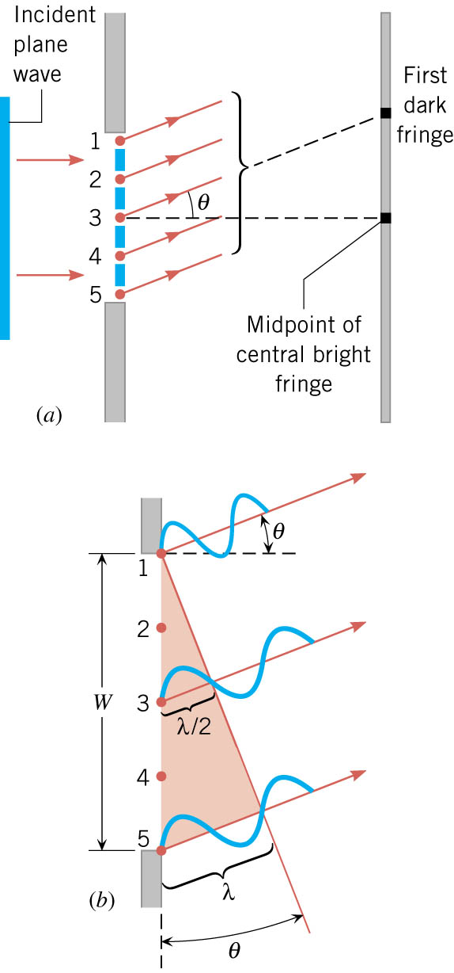
11-10 Single Slit Diffraction, Limits of Resolution, Thin Film Interference
$$\sin{θ=\frac{λ}{W}}$$
For multiple dark fringes
$$\sin{θ}=m\frac{λ}{W}$$
Where
θ = angle between wave and normal to slit
m = dark band order
λ = wavelength
W = width of slit
Notes:
The screen is far from the single slit so that wavelets are parallel. We are looking at the part of the wavelets that are traveling at an angle to the normal.

Slide 99
11-10 Single Slit Diffraction, Limits of Resolution, Thin Film Interference
A laser shines through a single slit of width $3.25×{10}^{−6}$ m. The first order dark fringe is 10.2 cm from the center and the slit is 50 cm from the screen. What is the wavelength of the laser?
650 nm
10.2 cm
11.53°
50 cm
Notes:
$$\tan{θ}=\frac{10.2 cm}{50 cm}→θ=\tan\left(\frac{10.2}{50}\right)=11.53°$$
$$\sin{θ}=m\frac{λ}{W}→\sin{11.53°}=1\frac{λ}{3.25×{10}^{−6} m }→6.496×{10}^{−7} m=λ$$

Slide 100
11-10 Single Slit Diffraction, Limits of Resolution, Thin Film Interference
Application – Microchip Production
Very small electrical components are used.
Make masks similar to photographic slides.
Light shines through the mask onto silicon wafers coated with photosensitive material.
The exposed portions are chemically removed later.
If too much diffraction occurs, the lines will overlap.
Currently UV rays which have smaller wavelengths than visible light is used to minimize λ/W ratio.
To improve could use X-rays or Gamma Rays with even smaller wavelengths.

Slide 101
11-10 Single Slit Diffraction, Limits of Resolution, Thin Film Interference
Light going through a circular aperture has diffraction
Also true for light from lens and mirrors
1st minimum at
$$θ=1.22\frac{λ}{D}$$
Where
$θ$ is in radians
$λ$ is the wavelength
D is the diameter of aperture, lens, mirror, etc.
Two light sources are “resolved” when one’s center is at the 1st minimum of the other

Slide 102
11-10 Single Slit Diffraction, Limits of Resolution, Thin Film Interference
(a) What is the minimum angular spread of a 633-nm wavelength He-Ne laser beam that is originally 1.00 mm in diameter? (b) If this laser is aimed at a mountain cliff 15.0 km away, how big will the illuminated spot be?
23.2 m
Notes:
$θ=1.22\frac{λ}{D}=1.22\frac{633×{10}^{−9} m}{1×{10}^{−3} m}=7.72×{10}^{−4} radians$
$\tan{θ}=\frac{y}{x}→\tan{7.72×{10}^{−4} rad}=\frac{y}{15000 m}→y=\left(15000 m\right)\tan{7.72×{10}^{−4} rad}=11.58 m$ $Y=2y+D=2\left(11.58 m\right)+1×{10}^{−3} m=23.2 m$

Slide 103
11-10 Single Slit Diffraction, Limits of Resolution, Thin Film Interference
Light interference depends on the ratio of its wavelength and the object size
If the object is near the size of the wavelength, there will be interference
Since each color of light is a different wavelength, light can be split using thin films
When light reflects from a medium having an index of refraction greater than that of the medium in which it is traveling, a 180$°$ phase change (or a λ / 2 shift) occurs

Slide 104
11-10 Single Slit Diffraction, Limits of Resolution, Thin Film Interference
The light hits the first surface.
Is it phase shifted? Only if n₂ > n₁
The transmitted light reflects off the second surface.
Is it phase shifted? Only if n₃ > n₂

Slide 105
11-10 Single Slit Diffraction, Limits of Resolution, Thin Film Interference
Destructive interference when
$2t=\frac{λ_{n}}{2}$ if both rays 1 and 2 phase shift
Or $2t=λ_{n}$ if only one ray phase shifts
Where $λ_{n}=\frac{λ}{n_{2}}$
Constructive interference when
$2t=λ_{n}$ if both rays 1 and 2 phase shift
Or $2t=\frac{λ_{n}}{2}$ if only one ray phase shifts
Notes:
Only if incident light is nearly perpendicular to surface
Difference in path length = ½ wavelength to get destructive interference

Slide 106
11-10 Single Slit Diffraction, Limits of Resolution, Thin Film Interference
An oil slick on water is 120 nm thick and illuminated by white light incident perpendicular to its surface. What color does the oil appear (what is the most constructively reflected wavelength), given its index of refraction is 1.40?
$λ=672 nm$, Red
Notes:
$$n_{1}=1.00 air$$
$$n_{2}=1.40 oil$$
$$n_{3}=1.33 water$$
Ray 1 phase shifts; Ray 2 no phase shift
We want constructive interference, so want difference of one wavelength
$$2t=\frac{λ_{n}}{2}=\frac{λ}{2n}$$
$$2\left(120×{10}^{−9} m\right)=\frac{λ}{2\left(1.40\right)}$$
$$λ=672×{10}^{−9} m=672 nm$$
Red

Slide 107
11-10 Homework
Lets not split this assignment up.
Read 27.8

Slide 108
11-11 Polarization
In this lesson you will…
• Discuss the meaning of polarization.

Slide 109
11-11 Polarization
Linearly polarized light vibrates in only one direction
Common non-polarized light vibrates in all directions perpendicular to the direction of travel.

Slide 110
11-11 Polarization
How to make EM waves polarized
Straight wire antenna
Reflections of flat surfaces
Passing through a polarizing material
Polarizing materials
Light is polarized along the transmission axis
All components of the wave are absorbed except the components parallel to the transmission axis
Since unpolarized light vibrates equally in all directions, the polarizing material absorbs ½ the light.
$I=\frac{1}{2}I_{0}$
Notes:
Have some polarizing filters
I = intensity of light

Slide 111
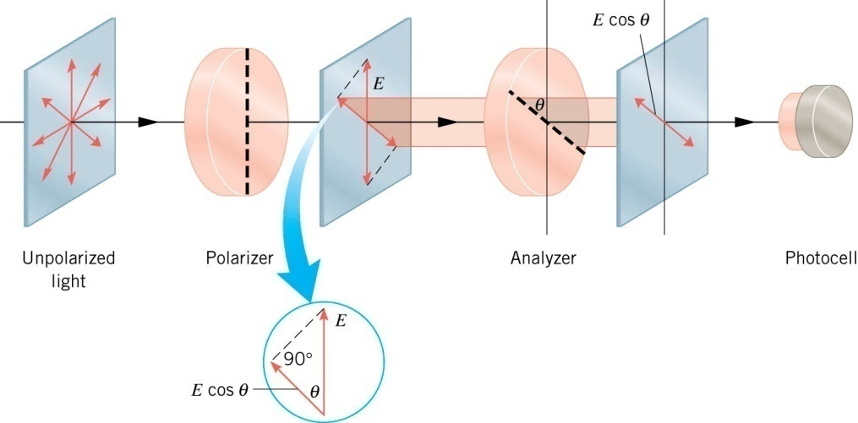
11-11 Polarization
Malus’s Law
After light has been polarized a second polarizer can be used to adjust the intensity of the transmitted light.
Polarizer polarizes the light. The analyzer polarizes the polarized light along another axis. It only transmits the component parallel to the transmission axis of the analyzer.
$$I=I_{0}\cos^{2}{θ}$$
Notes:
Us the overhead projector and two polarizing filters to demonstrate.
When polarizers cross at 90 degree no light is transmitted.
Its cos² because the intensity is proportional to the energy squared and the angle is found by E cos θ.

Slide 112
11-11 Polarization
Uses of polarization
Sunglasses
Automatically cuts light intensity in half
Often the sunlight is reflected off of flat surfaces like water, roads, car windshields, etc. With the correct polarization, the sunglasses can eliminate most of those waves.
3-D movies
Cameras are side-by-side.
The movies is projected by two projectors side by side, but polarized at 90°.
The audience wears glasses that have the same polarization so the right eye only sees the right camera and the left eye only sees the left camera.
LCD
Voltage changes the direction of the LCD polarization. The pixels turned on are transmitted (parallel), the pixel turned off are not transmitted (perpendicular).

Slide 113
11-11 Polarization
A certain camera lens uses two polarizing filters to decrease the intensity of light entering the camera. If the light intensity in the scene is 20 W/m², what is the intensity of the light between the two filters?
10 W/m²
If the light intensity at the film is 3 W/m², what is angle between the transmission axes of the polarizers?
56.8°
Notes:
$I=\frac{1}{2}I_{0}→I=\frac{1}{2}\left(20\frac{W}{m^{2}}\right)=10 W/m^{2}$
$S=S_{0} \cos^{2}θ→3=10 \cos^{2} θ→0.3=\cos^{2} θ→0.5477=\cos^{2} θ→θ=56.8°$

Slide 114
11-11 Polarization
Polarization by Reflection
Light polarized perpendicular to surface is more likely refracted
Light horizontal to surface is more likely reflected
Light is completely polarized at Brewster’s Angle
$$\tan{θ_{b}}=\frac{n_{2}}{n_{1}}$$
Where
$θ_{b}$ = Brewster’s angle
$n_{1}$ and $n_{2}$ are indices of refraction

Slide 115
11-11 Homework
Don’t let yourself become polarized with these problems.

